Slide 1
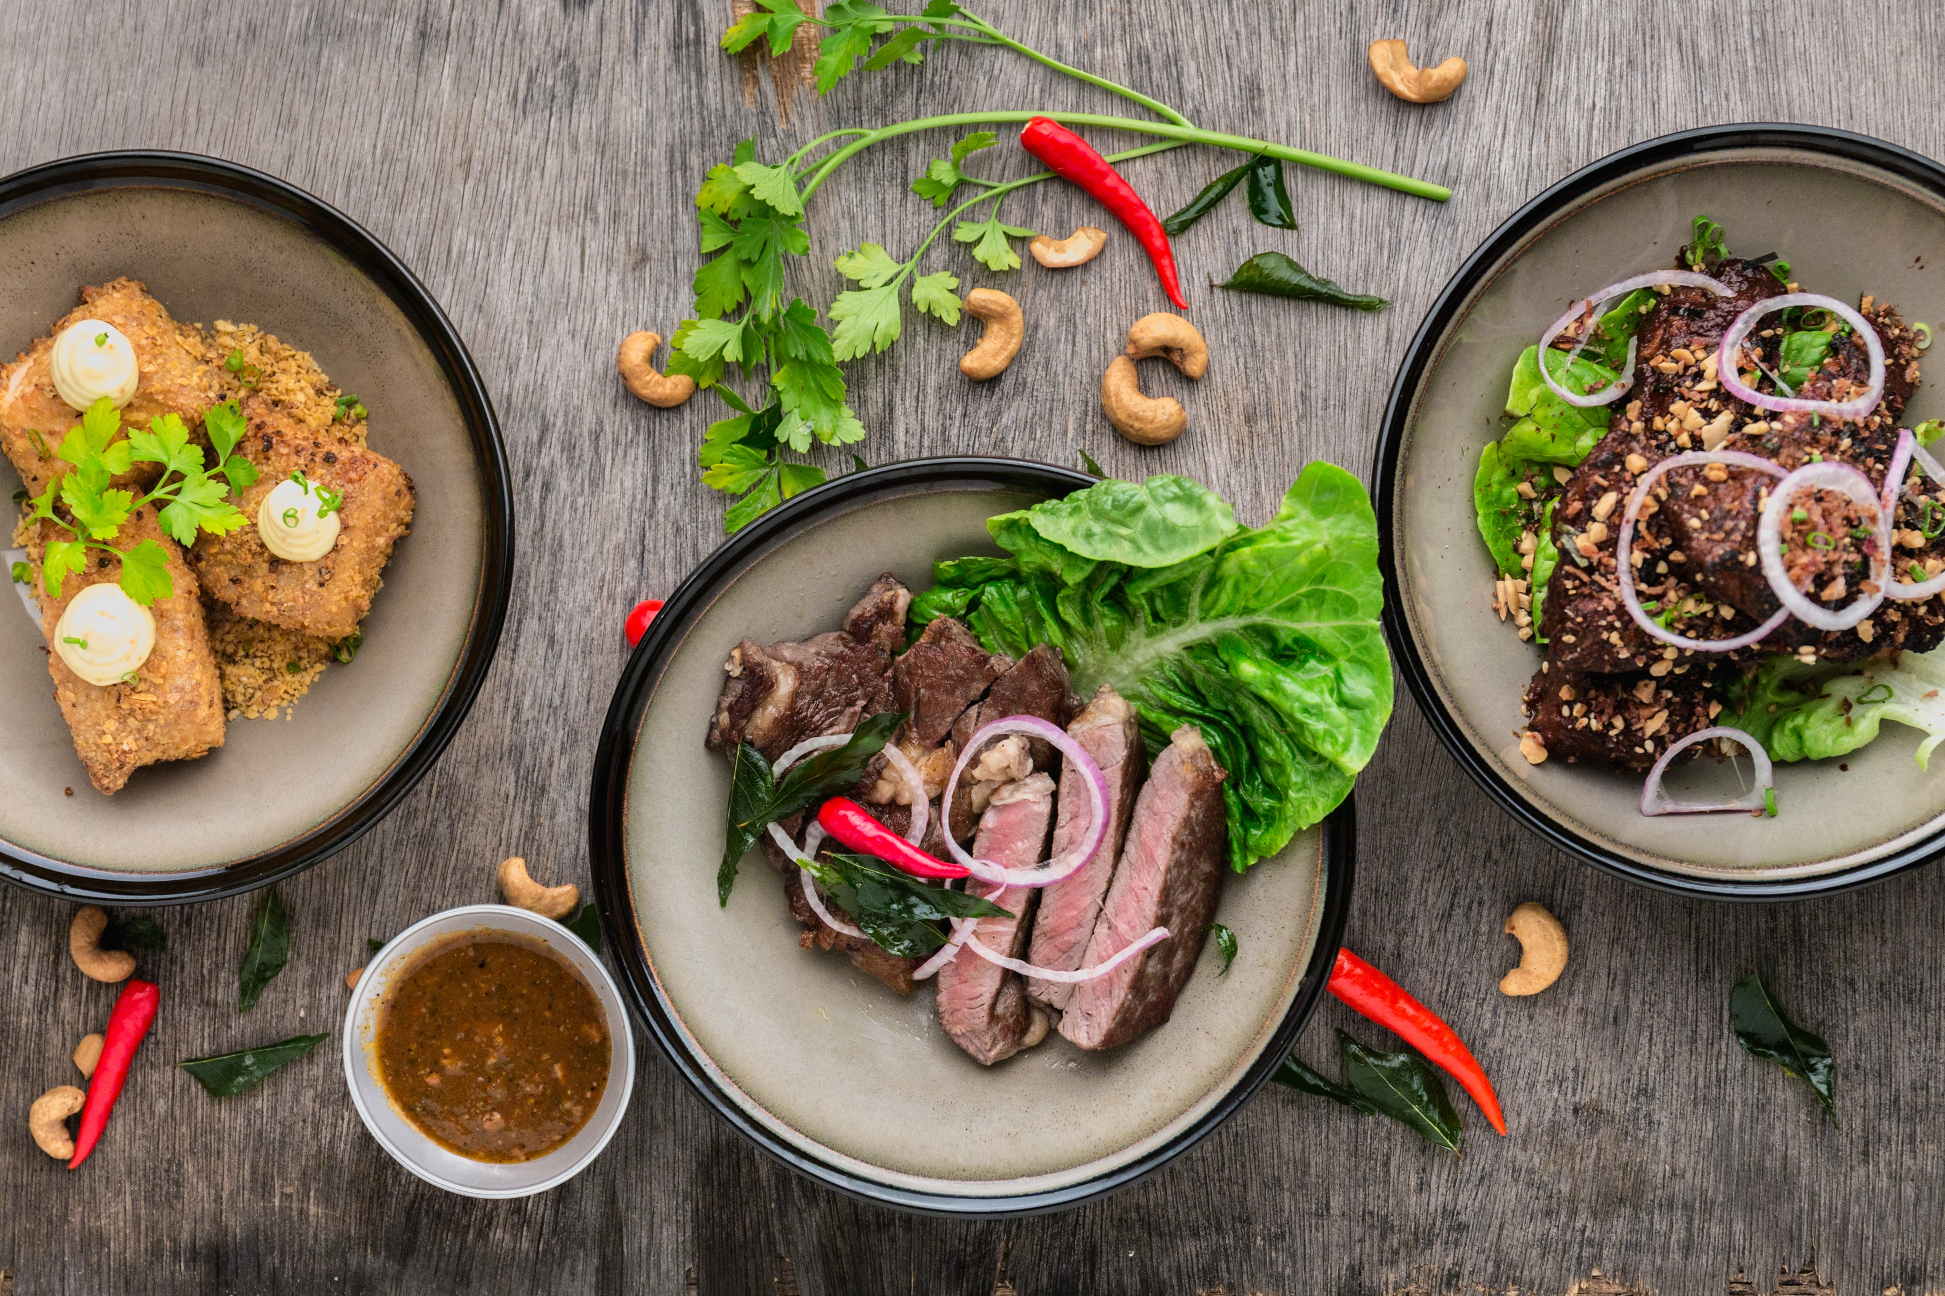
Website on food ordering system
31 - Ruchira Kadam
32 - Sanika Kamble
46 - Shruti Munot
“Instant Food for Instant Hunger…”

Slide 2



Tools we have used

Slide 3
Properties :
Portable Design
Suitable headings
Simple menu for navigation
Strive for consistency by utilizing familiar icons, colors, menu hierarchy

Slide 4
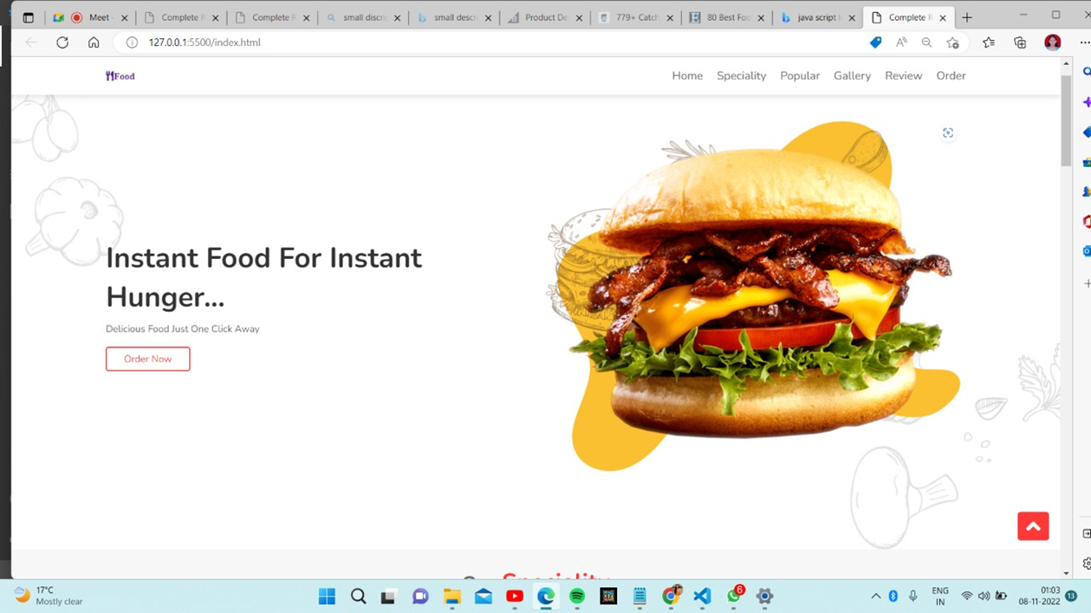


Slide 5
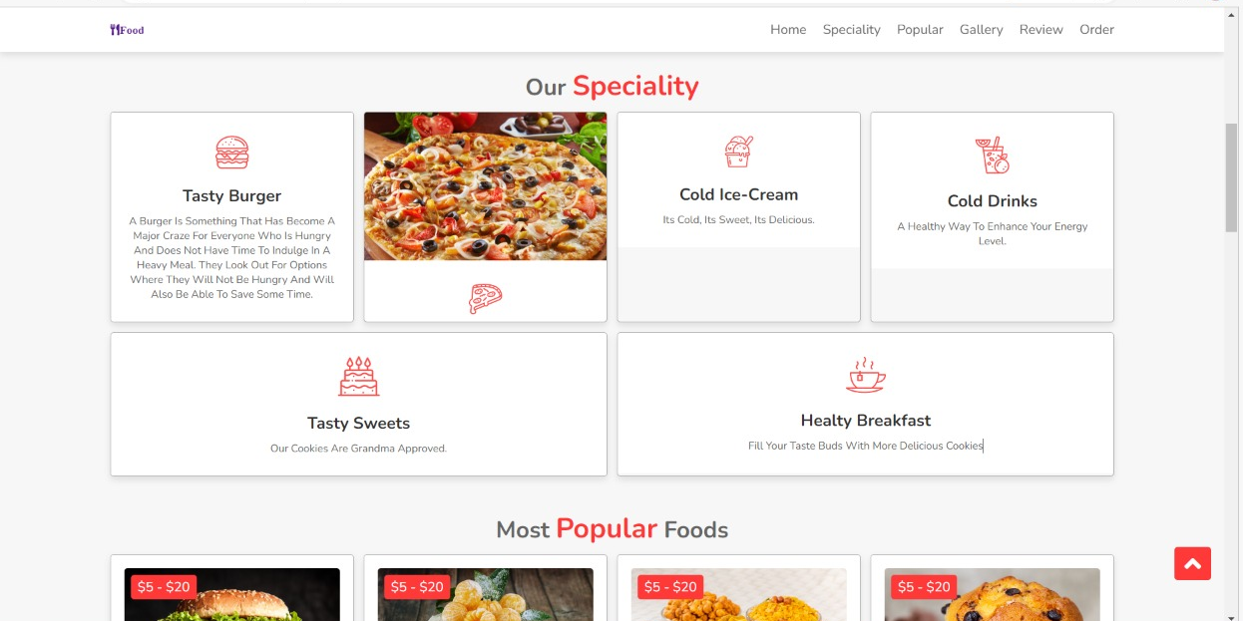
Here we have used different cards displaying special foods items with descriptions.

Slide 6
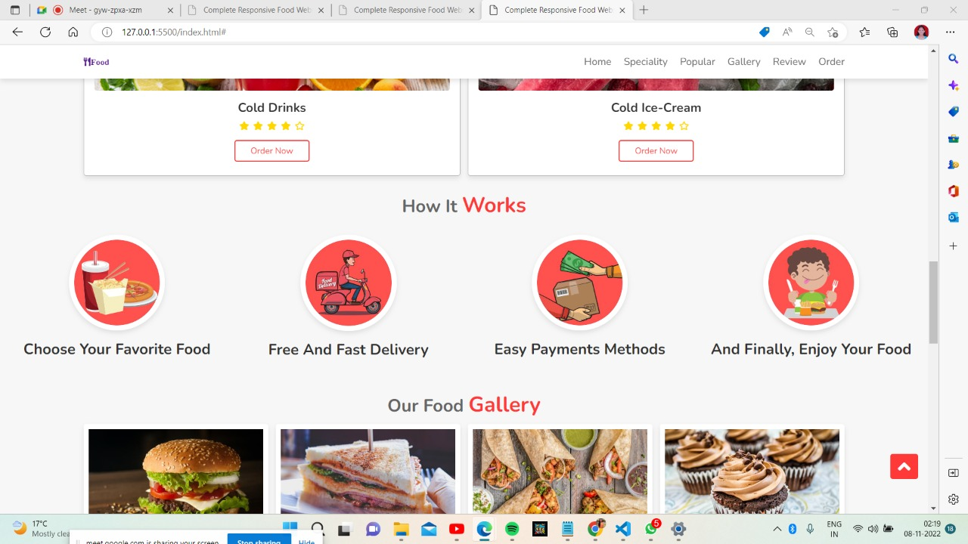
HOW IT WORKS

Slide 7
Thank You!

